Slide 1
UNIT III
JAVA SCRIPT

Slide 2
Introduction to JavaScript
JavaScript is a versatile, dynamically typed programming language used for interactive web applications, supporting both client-side and server-side development, and integrating seamlessly with HTML, CSS, and a rich standard library.
JavaScript is a single-threaded language which means it executes one task at a time.
It is an Interpreted language which means it executes the code line by line.
The data type of the variable is decided at run-time in JavaScript that’s why it is called dynamically typed.

Slide 3
Key Features of JavaScript
Client-Side Scripting: JavaScript runs on the user’s browser, so has a faster response time without needing to communicate with the server.
Versatile: JavaScript can be used for a wide range of tasks, from simple calculations to complex server-side applications.
Event-Driven: JavaScript can respond to user actions (clicks, keystrokes) in real-time.
Asynchronous: JavaScript can handle tasks like fetching data from servers without freezing the user interface.

Slide 4
Advantages
Saves time and bandwidth: Regardless of where you host JavaScript, it always gets executed on the client environment to save lots of bandwidth and make the execution process fast.
Compatible for all browsers: The biggest advantage of JavaScript having the ability to support all modern browsers and produce an equivalent result.
Community Support: Global companies support community development by creating important projects.
Vastly used: JavaScript is employed everywhere on the web.
Environment Support: JavaScript plays nicely with other languages and may be utilized in an enormous sort of application.

Slide 5
Advantages
Open source: Many open-source projects provide useful help for developers to add JavaScript.
Easy to use: It is not difficult to start working in JavaScript. For this reason, many of us prefer to start our adventure in the IT sector by learning this language. It gives the power to make rich interfaces.
Backend usage: There are some ways to use JavaScript through Node.js servers. It is possible to develop a whole JavaScript app from front to back using only JavaScript.

Slide 6
Datatypes
String Number Bigint Boolean Undefined Null Symbol Object
The Object Datatype
The object data type can contain both built-in objects, and user defined objects:
Built-in object types can be:
objects, arrays, dates, maps, sets, intarrays, floatarrays, promises, and more.

Slide 7
Types of JavaScript Operators
There are different types of JavaScript operators:
Arithmetic Operators
Assignment Operators
Comparison Operators
Logical Operators
Bitwise Operators
Ternary Operators
Type Operators

Slide 8
Operators : Assignment
The Assignment Operator (=) assigns a value to a variable:
<html>
<body>
<h1>JavaScript Operators</h1>
<h2>The = Operator</h2>

Slide 9
Operators : Assignment
let x = 5;
x += 3; // x = x + 3 => 5 + 3 = 8
console.log(x);
x -= 2; // x = x - 2 => 8 - 2 = 6
console.log(x);
x *= 4; // x = x * 4 => 6 * 4 = 24
console.log(x);
x /= 6; // x = x / 6 => 24 / 6 = 4
console.log(x);
x %= 2; // x = x % 2 => 4 % 2 = 0
console.log(x);

Slide 10
JavaScript Arithmetic
Arithmetic Operations

Slide 11
JavaScript Arithmetic
Arithmetic Operations
let a = 5;
let b = 3;
console.log(a + b); // Addition: 5 + 3 = 8
console.log(a - b); // Subtraction: 5 - 3 = 2
console.log(a * b); // Multiplication: 5 * 3 = 15
console.log(a / b); // Division: 5 / 3 = 1.666...
console.log(a % b); // Modulus (Remainder): 5 % 3 = 2
console.log(a++); // Increment: 5 -> 6
console.log(--b); // Decrement: 3 -> 2

Slide 12
JavaScript Comparison Operators
let x = 10;
let y = 20;
console.log(x == y); // Equal to: false (10 is not equal to 20)
console.log(x === "10"); // Strict Equal to: false (different types)
console.log(x != y); // Not equal to: true (10 is not 20)
console.log(x !== "10"); // Strict Not Equal to: true (different types)
console.log(x > y); // Greater than: false (10 is not greater than 20)
console.log(x < y); // Less than: true (10 is less than 20)
console.log(x >= 10); // Greater than or equal to: true (10 is equal to 10)
console.log(x <= 5); // Less than or equal to: false (10 is not less than 5)

Slide 13
JavaScript Logical Operators
let a = true;
let b = false;
console.log(a && b); // Logical AND: false (both need to be true)
console.log(a || b); // Logical OR: true (one of them is true)
console.log(!a); // Logical NOT: false (inverts the value)

Slide 14
JavaScript Ternary Operators
let age = 18;
let result = (age >= 18) ? "Adult" : "Minor";
console.log(result); // Output: "Adult"
expression1?expression2:expression3;

Slide 15
JavaScript Typeof Operators
let x = 5;
console.log(typeof x); // Typeof: "number"
let y = "Hello";
console.log(typeof y); // Typeof: "string"
let z = [1, 2, 3];
console.log(typeof z); // Typeof: "object"
let obj = { name: "Alice" };
console.log(obj instanceof Object); // true (obj is an instance of Object)

Slide 16
JavaScript BitWise Operators
let x = 5; // In binary: 0101
let y = 3; // In binary: 0011
console.log(x & y); // Bitwise AND: 0101 & 0011 = 0001 (1)
console.log(x | y); // Bitwise OR: 0101 | 0011 = 0111 (7)
console.log(x ^ y); // Bitwise XOR: 0101 ^ 0011 = 0110 (6)
console.log(~x); // Bitwise NOT: ~0101 = 1010 (-6)
console.log(x << 1); // Left Shift: 0101 << 1 = 1010 (10)
console.log(x >> 1); // Right Shift: 0101 >> 1 = 0010 (2)

Slide 17
OTHER WAY

Slide 18
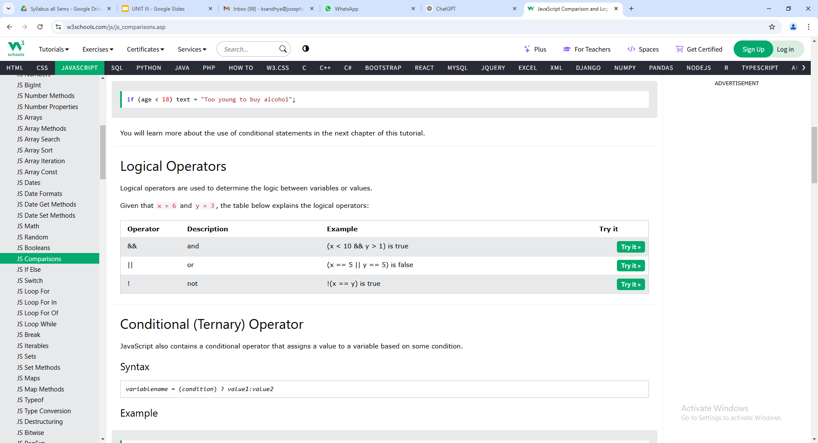
Logical Operators

Slide 19
<html>
<body>
<h1>JavaScript Comparison</h1>
<h2>The && Operator (Logical AND)</h2>
<p>The && operator returns true if both expressions are true, otherwise it returns false.</p>
<p id="demo"></p>
<script>
let x = 6;
let y = 3;
document.getElementById("demo").innerHTML =
(x < 10 && y > 1) + "<br>" +
(x < 10 && y < 1);
</script>
</body>
</html>

Slide 20
Output
JavaScript Comparison
The && Operator (Logical AND)
The && operator returns true if both expressions are true, otherwise it returns false.
true false

Slide 21
LOGICAL OR OPERATOR
<html>
<body>
<h1>JavaScript Comparison</h1>
<h2>The || Operator (Logical OR)</h2>
<p>The || returns true if one or both expressions are true, otherwise it returns false.</p>
<p id="demo"></p>
<script>
let x = 6;
let y = 3;

Slide 22
document.getElementById("demo").innerHTML =
(x == 5 || y == 5) + "<br>" +
(x == 6 || y == 0) + "<br>" +
(x == 0 || y == 3) + "<br>" +
(x == 6 || y == 3);
</script>
</body>
</html>

Slide 23
OUTPUT
JavaScript Comparison
The || Operator (Logical OR)
The || returns true if one or both expressions are true, otherwise it returns false.
false true true true

Slide 24
LOGICAL NOT OPERATOR
<html>
<body>
<h2>JavaScript Comparison</h2>
<p>The NOT operator (!) returns true for false statements and false for true statements.</p>
<p id="demo"></p>
<script>
let x = 6;
let y = 3;

Slide 25
document.getElementById("demo").innerHTML =
!(x === y) + "<br>" +
!(x > y);
</script>
</body>
</html>

Slide 26
OUTPUT
JavaScript Comparison
The NOT operator (!) returns true for false statements and false for true statements.
true false

Slide 27
JavaScript Arrays
https://www.w3schools.com/js/js_arrays.asp
An array is a special variable, which can hold more than one value:
<html>
<body>
<h1>JavaScript Arrays</h1>
<p id="demo"></p>
<script>
const cars = ["Saab", "Volvo", "BMW"];
document.getElementById("demo").innerHTML = cars;
</script>
</body>
</html>
OUTPUT
JavaScript Arrays
Saab,Volvo,BMW

Slide 28
Creating an Array
Using an array literal is the easiest way to create a JavaScript Array.
Syntax:
const array_name = [item1, item2, ...];
<html>
<body>
<h1>JavaScript Arrays</h1>
<p id="demo"></p>
<script>
const cars = [
"Saab",
"Volvo",
"BMW"
];
document.getElementById("demo").innerHTML = cars;
</script>
</body>
</html>
OUTPUT JavaScript Arrays
Saab,Volvo,BMW

Slide 29
You can also create an array, and then provide the elements:
<html>
<body>
<h1>JavaScript Arrays</h1>
<p id="demo"></p>
<script>
const cars = [];
cars[0]= "Saab";
cars[1]= "Volvo";
cars[2]= "BMW";
document.getElementById("demo").innerHTML = cars;
</script>
</body>
</html>
OUTPUT
JavaScript Arrays
Saab,Volvo,BMW

Slide 30
Using the JavaScript Keyword new
The following example also creates an Array, and assigns values to it:
<html>
<body>
<h1>JavaScript Arrays</h1>
<p id="demo"></p>
<script>
const cars = new Array("Saab", "Volvo", "BMW");
document.getElementById("demo").innerHTML = cars;
</script>
</body>
</html>
OUTPUT
JavaScript Arrays
Saab,Volvo,BMW

Slide 31
Accessing Array Elements
You access an array element by referring to the index number:
<html>
<body>
<h1>JavaScript Arrays</h1>
<h2>Bracket Indexing</h2>
<p>JavaScript array elements are accessed using numeric indexes (starting from 0).</p>
<p id="demo"></p>
<script>
const cars = ["Saab", "Volvo", "BMW"];
document.getElementById("demo").innerHTML = cars[0];
</script>
</body>
</html>

Slide 32
OUTPUT
JavaScript Arrays
Bracket Indexing
JavaScript array elements are accessed using numeric indexes (starting from 0).
Saab
Changing an Array Element
This statement changes the value of the first element in cars:

Slide 33
<html>
<body>
<h1>JavaScript Arrays</h1>
<h2>Bracket Indexing</h2>
<p>JavaScript array elements are accessed using numeric indexes (starting from 0).</p>
<p id="demo"></p>
<script>
const cars = ["Saab", "Volvo", "BMW"];
cars[0] = "Opel";
document.getElementById("demo").innerHTML = cars;
</script>
</body>
</html>

Slide 34
OUTPUT
JavaScript Arrays
Bracket Indexing
JavaScript array elements are accessed using numeric indexes (starting from 0).
Opel,Volvo,BMW

Slide 35
JavaScript Array Methods
Array length
The length property returns the length (size) of an array:
<html>
<body>
<h1>JavaScript Arrays</h1>
<h2>The length Property</h2>
<p>The length property returns the length of an array:</p>
<p id="demo"></p>
<script>
const fruits = ["Banana", "Orange", "Apple", "Mango"];
let size = fruits.length;
document.getElementById("demo").innerHTML = size;
</script>
</body>
</html>

Slide 36
OUTPUT
JavaScript Arrays
The length Property
The length property returns the length of an array:
4

Slide 37
Array toString()
The JavaScript method toString() converts an array to a string of (comma separated) array values.
<html>
<body>
<h1>JavaScript Arrays</h1>
<h2>The toString() Method</h2>
<p>The toString() method returns an array as a comma separated string:</p>
<p id="demo"></p>
<script>
const fruits = ["Banana", "Orange", "Apple", "Mango"];
document.getElementById("demo").innerHTML = fruits.toString();
</script>
</body>
</html>

Slide 38
OUTPUT
JavaScript Arrays
The toString() Method
The toString() method returns an array as a comma separated string:
Banana,Orange,Apple,Mango

Slide 39
join()
The join() method also joins all array elements into a string.
It behaves just like toString(), but in addition you can specify the separator:
<html>
<body>
<h1>JavaScript Arrays</h1>
<h2>The join() Method</h2>
<p>The join() method joins array elements into a string.</p>
<p>It this example we have used " * " as a separator between the elements:</p>
<p id="demo"></p>
<script>
const fruits = ["Banana", "Orange", "Apple", "Mango"];
document.getElementById("demo").innerHTML = fruits.join(" * ");
</script>
</body>
</html>

Slide 40
OUTPUT
JavaScript Arrays
The join() Method
The join() method joins array elements into a string.
It this example we have used " * " as a separator between the elements:
Banana * Orange * Apple * Mango

Slide 41
pop()
The pop() method removes the last element from an array:
<html>
<body>
<h1>JavaScript Arrays</h1>
<h2>The pop() Method</h2>
<p>The pop() method removes the last element from an array.</p>
<p id="demo1"></p>
<p id="demo2"></p>
<script>
const fruits = ["Banana", "Orange", "Apple", "Mango"];
document.getElementById("demo1").innerHTML = fruits;
fruits.pop();
document.getElementById("demo2").innerHTML = fruits;
</script>
</body>
</html>

Slide 42
OUTPUT
JavaScript Arrays
The pop() Method
The pop() method removes the last element from an array.
Banana,Orange,Apple,Mango
Banana,Orange,Apple

Slide 43
push()
The push() method adds a new element to an array (at the end):
<html>
<body>
<h1>JavaScript Arrays</h1>
<h2>The push() Method</h2>
<p>The push() method appends a new element to an array:</p>
<p id="demo1"></p>
<p id="demo2"></p>
<script>
const fruits = ["Banana", "Orange", "Apple", "Mango"];
document.getElementById("demo1").innerHTML = fruits;
fruits.push("Kiwi");
document.getElementById("demo2").innerHTML = fruits;
</script>
</body>
</html>

Slide 44
OUTPUT
JavaScript Arrays
The push() Method
The push() method appends a new element to an array:
Banana,Orange,Apple,Mango
Banana,Orange,Apple,Mango,Kiwi

Slide 45
Conditional Statements
Conditional statements are used to perform different actions based on different conditions.
In JavaScript we have the following conditional statements:
Use if to specify a block of code to be executed, if a specified condition is true
Use else to specify a block of code to be executed, if the same condition is false
Use else if to specify a new condition to test, if the first condition is false
Use switch to specify many alternative blocks of code to be executed

Slide 46
The if Statement
Use the if statement to specify a block of JavaScript code to be executed if a condition is true.
Syntax
if (condition) {
// block of code to be executed if the condition is true
}
Note that if is in lowercase letters. Uppercase letters (If or IF) will generate a JavaScript error.

Slide 47
<html>
<body>
<h2>JavaScript if</h2>
<p>Display "Good day!" if the hour is less than 18:00:</p>
<p id="demo">Good Evening!</p>
<script>
let a=18
if (a < 18) {
document.getElementById("demo").innerHTML = "Good day”
}
</script>
</body>
</html>

Slide 48
OUTPUT
JavaScript if
Display "Good day!" if the hour is less than 18:00:
Good day!

Slide 49
The else Statement
Use the else statement to specify a block of code to be executed if the condition is false.
if (condition) {
// block of code to be executed if the condition is true
} else {
// block of code to be executed if the condition is false
}

Slide 50
<html>
<body>
<h2>JavaScript if .. else</h2>
<p>A time-based greeting:</p>
<p id="demo"></p>
<script>
const hour = new Date().getHours();
let greeting;
if (hour < 18) {
greeting = "Good day";
} else {
greeting = "Good evening";
}
document.getElementById("demo").innerHTML = greeting;
</script>
</body>
</html>

Slide 51
JavaScript if .. else
A time-based greeting:
Good day

Slide 52
The else if Statement
Use the else if statement to specify a new condition if the first condition is false.
Syntax
if (condition1) {
// block of code to be executed if condition1 is true
} else if (condition2) {
// block of code to be executed if the condition1 is false and condition2 is true
} else {
// block of code to be executed if the condition1 is false and condition2 is false
}

Slide 53
<html>
<body>
<h2>JavaScript if .. else</h2>
<p>A time-based greeting:</p>
<p id="demo"></p>
<script>
const time = new Date().getHours();
let greeting;
if (time < 10) {
greeting = "Good morning";
} else if (time < 20) {
greeting = "Good day";
} else {
greeting = "Good evening";
}
document.getElementById("demo").innerHTML = greeting;
</script>
</body>
</html>

Slide 54
OUTPUT
JavaScript if .. else
A time-based greeting:
Good day

Slide 55
Switch Statement
Use the switch statement to select one of many code blocks to be executed.
Syntax
switch(expression) {
case x:
// code block
break;
case y:
// code block
break;
default:
// code block
}

Slide 56
This is how it works:
The switch expression is evaluated once.
The value of the expression is compared with the values of each case.
If there is a match, the associated block of code is executed.
If there is no match, the default code block is executed.

Slide 57
<html>
<body>
<h2>JavaScript switch</h2>
<p id="demo"></p>
<script>
let day;
switch (new Date().getDay()) {
case 0:
day = "Sunday";
break;
case 1:
day = "Monday";
break;
case 2:
day = "Tuesday";
break;
case 3:
day = "Wednesday";
break;

Slide 58
case 4:
day = "Thursday";
break;
case 5:
day = "Friday";
break;
case 6:
day = "Saturday";
}
document.getElementById("demo").innerHTML = "Today is " + day;
</script>
</body>
</html>

Slide 59
OUTPUT
JavaScript switch
Today is Monday

Slide 60
OUTPUT
JavaScript switch
Today is Monday

Slide 61
Loops
Loops can execute a block of code a number of times.
JavaScript supports different kinds of loops:
for - loops through a block of code a number of times
for/in - loops through the properties of an object
for/of - loops through the values of an iterable object
while - loops through a block of code while a specified condition is true
do/while - also loops through a block of code while a specified condition is true

Slide 62
The For Loop
The for statement creates a loop with 3 optional expressions:
for (expression 1; expression 2; expression 3) {
// code block to be executed
}
Expression 1 is executed (one time) before the execution of the code block.
Expression 2 defines the condition for executing the code block.
Expression 3 is executed (every time) after the code block has been executed.

Slide 63
<html>
<body>
<h2>JavaScript For Loop</h2>
<p id="demo"></p>
<script>
let text = "";
for (let i = 0; i < 5; i++) {
text += "The number is " + i + "<br>";
}
document.getElementById("demo").innerHTML = text;
</script>
</body>
</html>

Slide 64
JavaScript For Loop
The number is 0 The number is 1 The number is 2 The number is 3 The number is 4

Slide 65
For In Loop
The JavaScript for in statement loops through the properties of an Object:
Syntax
for (key in object) {
// code block to be executed
}

Slide 66
<html>
<body>
<h2>JavaScript For In Loop</h2>
<p>The for in statement loops through the properties of an object:</p>
<p id="demo"></p>
<script>
const person = {fname:"John", lname:"Doe", age:25};
let txt = "";
for (let x in person) {
txt += person[x] + " ";
}
document.getElementById("demo").innerHTML = txt;
</script>
</body>
</html>

Slide 67
JavaScript For In Loop
The for in statement loops through the properties of an object:
John Doe 25

Slide 68
For Of Loop
The JavaScript for of statement loops through the values of an iterable object.
It lets you loop over iterable data structures such as Arrays, Strings, Maps, NodeLists, and more:
Syntax
for (variable of iterable) {
// code block to be executed
}
variable - For every iteration the value of the next property is assigned to the variable. Variable can be declared with const, let, or var.
iterable - An object that has iterable properties.

Slide 69
<html>
<body>
<h2>JavaScript For Of Loop</h2>
<p>The for of statement loops through the values of any iterable object:</p>
<p id="demo"></p>
<script>
const cars = ["BMW", "Volvo", "Mini"];
let text = "";
for (let x of cars) {
text += x + "<br>";
}
document.getElementById("demo").innerHTML = text;
</script>

Slide 70
</body>
</html>
Output
JavaScript For Of Loop
The for of statement loops through the values of any iterable object:
BMW Volvo Mini

Slide 71
While Loop
The while loop loops through a block of code as long as a specified condition is true.
Syntax
while (condition) {
// code block to be executed
}

Slide 72
<html>
<body>
<h2>JavaScript While Loop</h2>
<p id="demo"></p>
<script>
let text = "";
let i = 0;
while (i < 10) {
text += "<br>The number is " + i;

Slide 73
i++;
}
document.getElementById("demo").innerHTML = text;
</script>
</body>
</html>

Slide 74
JavaScript While Loop
The number is 0 The number is 1 The number is 2 The number is 3 The number is 4 The number is 5 The number is 6 The number is 7 The number is 8 The number is 9

Slide 75
Do While Loop
The do while loop is a variant of the while loop. This loop will execute the code block once, before checking if the condition is true, then it will repeat the loop as long as the condition is true.
Syntax
do {
// code block to be executed
}
while (condition);

Slide 76
<html>
<body>
<h2>JavaScript Do While Loop</h2>
<p id="demo"></p>
<script>
let text = ""
let i = 0;
do {
text += "<br>The number is " + i;

Slide 77
i++;
}
while (i < 10);
document.getElementById("demo").innerHTML = text;
</script>
</body>
</html>

Slide 78
JavaScript Do While Loop
The number is 0 The number is 1 The number is 2 The number is 3 The number is 4 The number is 5 The number is 6 The number is 7 The number is 8 The number is 9

Slide 79
JavaScript User Defined Functions
JavaScript Function Definitions
JavaScript functions are defined with the function keyword.
You can use a function declaration or a function expression.
Function Declarations
Earlier in this tutorial, you learned that functions are declared with the following syntax:
function functionName(parameters) {
// code to be executed
}
Declared functions are not executed immediately. They are "saved for later use", and will be executed later, when they are invoked (called upon).

Slide 80
<!DOCTYPE html>
<html>
<body>
<h1>JavaScript Functions</h1>
<p>Call a function which performs a calculation and returns the result:</p>
<p id="demo"></p>
<script>
let x = myFunction(4, 3);
document.getElementById("demo").innerHTML = x;
function myFunction(a, b) {
return a * b;
}
</script>
</body>
</html>

Slide 81
output
JavaScript Functions
Call a function which performs a calculation and returns the result:
12

Slide 82
Function Expressions
A JavaScript function can also be defined using an expression.
A function expression can be stored in a variable:

Slide 83
<!DOCTYPE html>
<html>
<body>
<h2>JavaScript Functions</h2>
<p>A function can be stored in a variable:</p>
<p id="demo"></p>
<script>
const x = function (a, b) {return a * b};
document.getElementById("demo").innerHTML = x;
</script>
</body>
</html>

Slide 84
output
JavaScript Functions
A function can be stored in a variable:
function (a, b) {return a * b}

Slide 85
After a function expression has been stored in a variable, the variable can be used as a function:
<!DOCTYPE html>
<html>
<body>
<h2>JavaScript Functions</h2>
<p>After a function has been stored in a variable,
the variable can be used as a function:</p>
<p id="demo"></p>
<script>
const x = function (a, b) {return a * b};
document.getElementById("demo").innerHTML = x(4, 3);
</script>
</body>
</html>

Slide 86
output
JavaScript Functions
After a function has been stored in a variable, the variable can be used as a function:
12

Slide 87
output
JavaScript Functions
After a function has been stored in a variable, the variable can be used as a function:
12

Slide 88
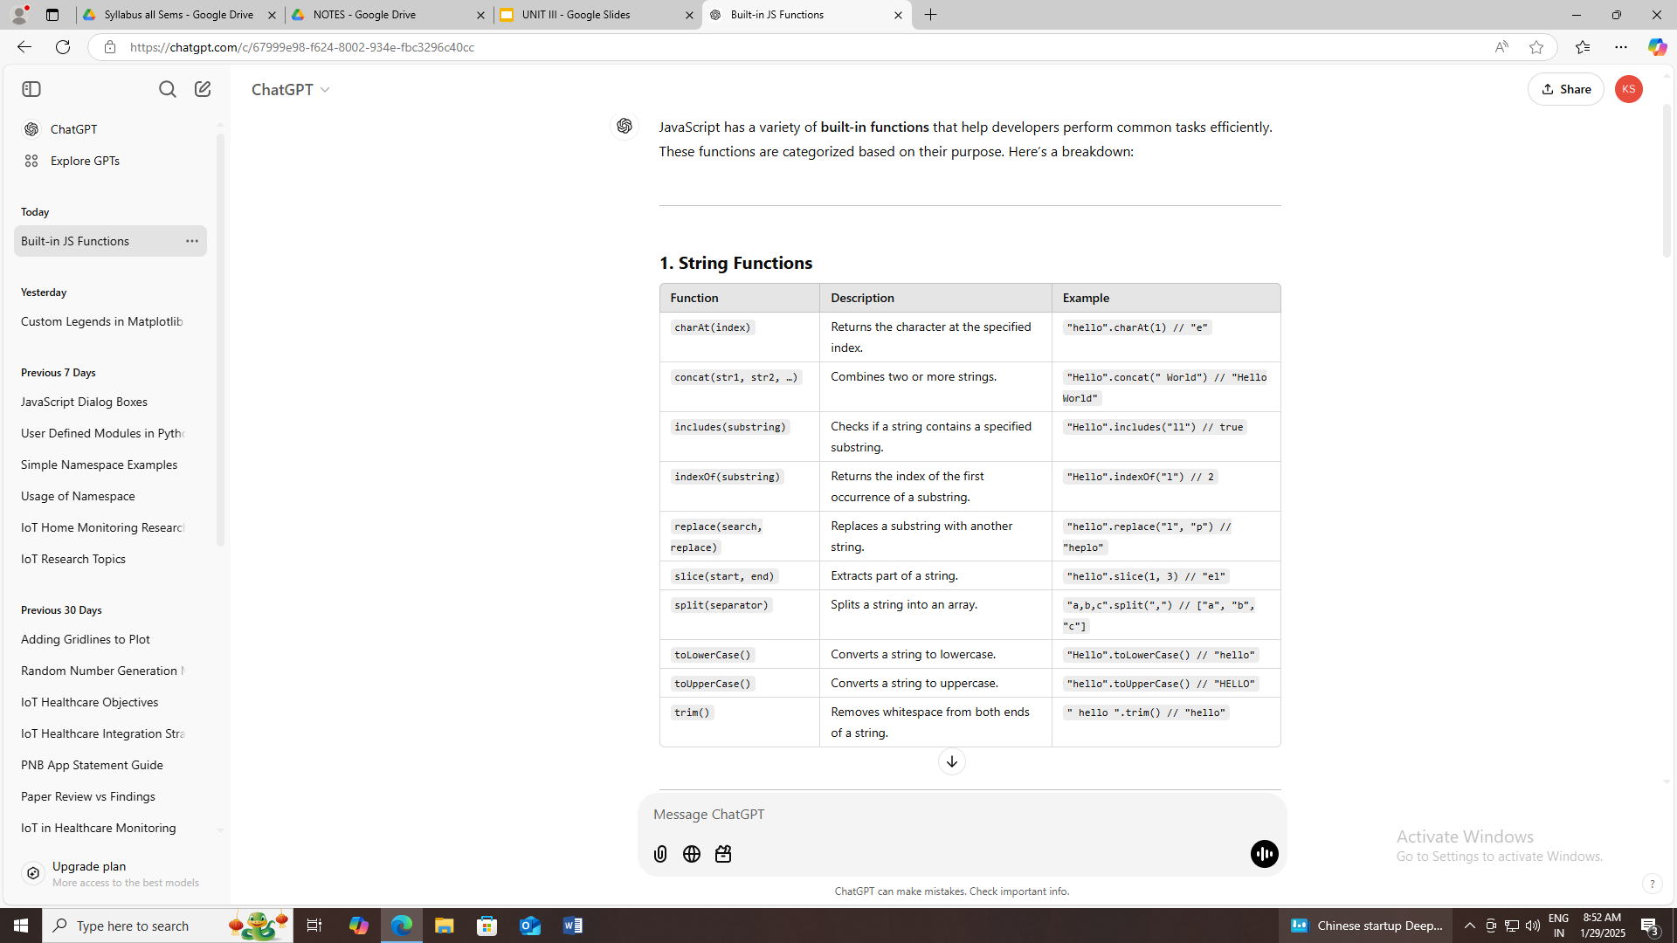
BUILT-IN FUNCTIONS
JavaScript has a variety of built-in functions that help developers perform common tasks efficiently.

Slide 89
<html>
<body>
<h2>JavaScript Functions</h2>
<p>After a function has been stored in a variable,
the variable can be used as a function:</p>
<p id="demo"></p>
<script>
document.getElementById("demo").innerHTML = "hello".charAt(1)
</script>
</body>
</html>
Output: e

Slide 90
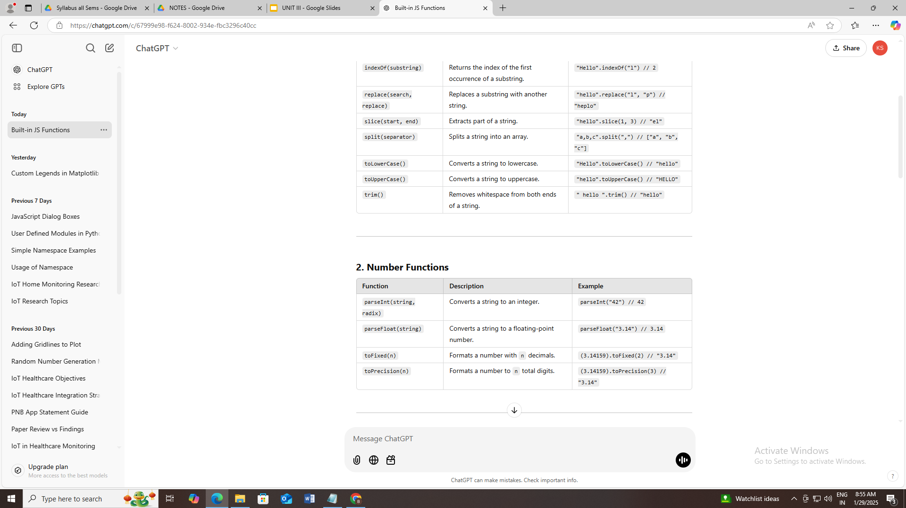

Slide 91
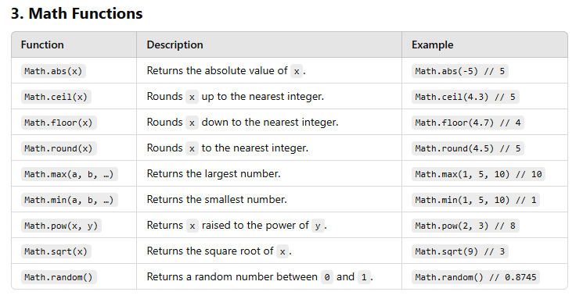

Slide 92
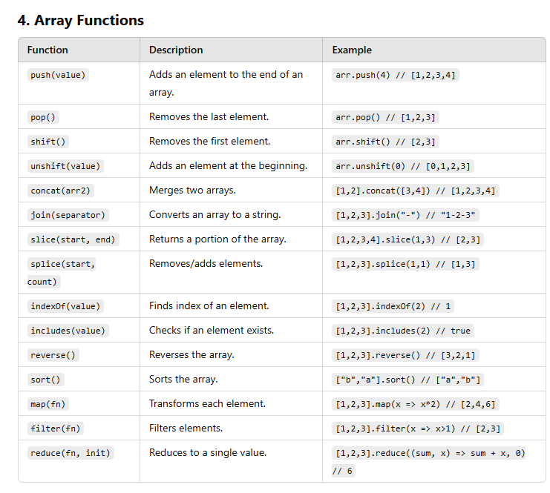

Slide 93
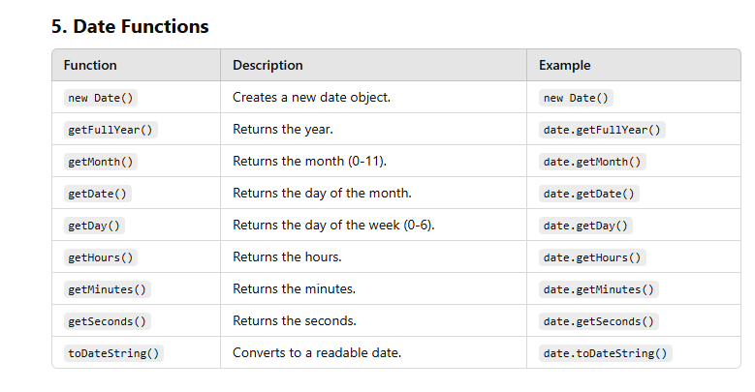

Slide 94
JavaScript Dialogue Boxes
Dialogue boxes are a kind of popup notification, this kind of informative functionality is used to show success, failure, or any particular/important notification to the user.
JavaScript uses 3 kinds of dialog boxes:
Alert
Prompt
Confirm
These dialog boxes can be of very much help in making our website look more attractive.
Alert Box: An alert box is used on the website to show a warning message to the user that they have entered the wrong value other than what is required to fill in that position. Nonetheless, an alert box can still be used for friendlier messages. The alert box gives only one button “OK” to select and proceed.

Slide 95
<script type="text/javascript">
function Warning() {
alert ("Warning danger you have not filled everything");
}
</script>
<p>Click the button to check the Alert Box functionality</p>
<form>
<input type="button" value="Click Me" onclick="Warning();" />
</form>

Slide 96
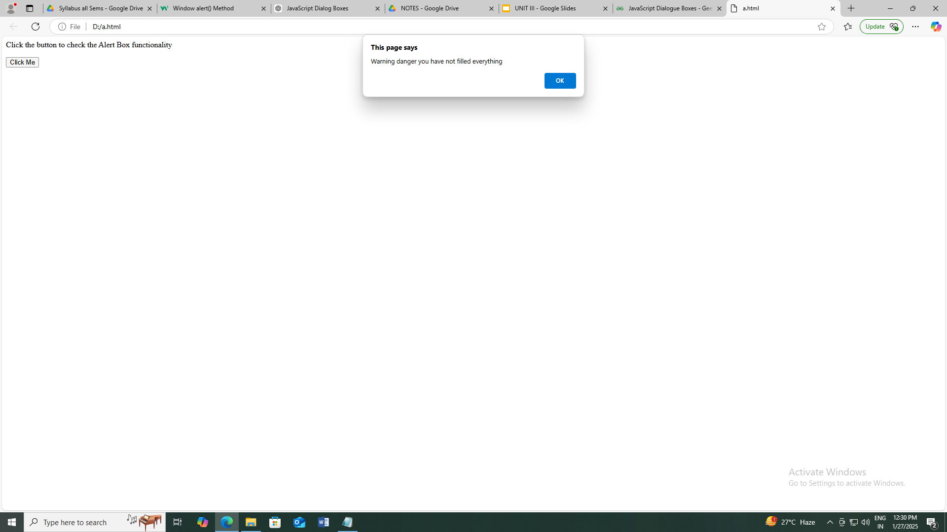

Slide 97
Confirm box: A confirm box is often used if you want the user to verify or accept something. When a confirm box pops up, the user will have to click either “OK” or “Cancel” to proceed. If the user clicks on the OK button, the window method confirm() will return true. If the user clicks on the Cancel button, then confirm() returns false and will show null.

Slide 98
<script type="text/javascript">
function Confirmation() {
var Val = confirm("Do you want to continue ?");
if (Val == true) {
return true;
} else {
return false;
}
}
</script>
<p>Click the button to check the Confirm Box functionality</p>
<form>
<input type="button" value="Click Me" onclick="Confirmation();" />
</form>

Slide 99
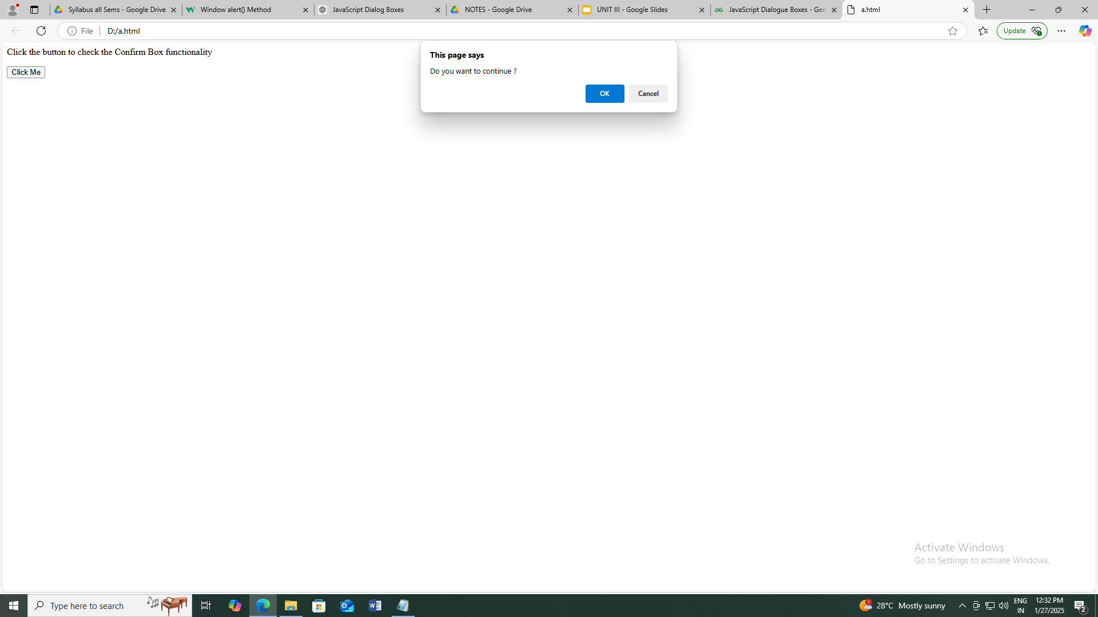

Slide 100
Prompt Box: A prompt box is often used if you want the user to input a value before entering a page. When a prompt box pops up, the user will have to click either “OK” or “Cancel” to proceed after entering an input value. If the user clicks the OK button, the window method prompt() will return the entered value from the text box. If the user clicks the Cancel button, the window method prompt() returns null.

Slide 101
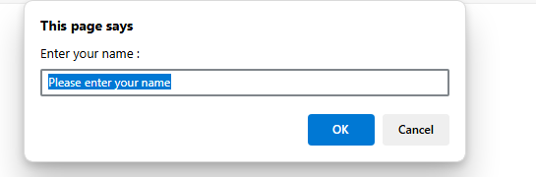
<script type="text/javascript">
function Value(){
var Val = prompt("Enter your name : ", "Please enter your name");
document.getElementById(Val)
}
</script>
<p>Click the button to check the Prompt Box functionality</p>
<form>
<input type="button" value="Click Me" onclick="Value();" />
</form>

Slide 102
<script type="text/javascript">
function Value(){
var Val = prompt("Enter your name : ", "Please enter your name");
document.getElementById(Val)
}
</script>
<p>Click the button to check the Prompt Box functionality</p>
<form>
<input type="button" value="Click Me" onclick="Value();" />
</form>

Slide 103
Browser Object
The Window Object
The window object is supported by all browsers. It represents the browser's window.
All global JavaScript objects, functions, and variables automatically become members of the window object.
Global variables are properties of the window object.
Global functions are methods of the window object.
Even the document object (of the HTML DOM) is a property of the window object:

Slide 104
Window Size
Two properties can be used to determine the size of the browser window.
Both properties return the sizes in pixels:
window.innerHeight - the inner height of the browser window (in pixels)
window.innerWidth - the inner width of the browser window (in pixels)
<html>
<body>
<h2>JavaScript Window</h2>
<p id="demo"></p>
<script>
document.getElementById("demo").innerHTML =
"Browser inner window width: " + window.innerWidth + "px<br>" +
"Browser inner window height: " + window.innerHeight + "px";
</script>
</body>
</html>

Slide 105
output
JavaScript Window
Browser inner window width: 941px Browser inner window height: 807px
Window Screen
The window.screen object can be written without the window prefix.
Properties:
screen.width
screen.height
screen.availWidth
screen.availHeight
screen.colorDepth
screen.pixelDepth
Window Screen Width
The screen.width property returns the width of the visitor's screen in pixels.

Slide 106
<html>
<body>
<p id="demo"></p>
<script>
document.getElementById("demo").innerHTML =
"Screen width is " + screen.width;
</script>
</body>
</html>
Output
Screen width is 1920

Slide 107
Navigator Object : The navigator object provides information about the browser.
screen Object The screen object provides information about the user's screen.
history Object The history object allows navigation through the browser’s session history.

Slide 108
EVENTS : HTML events are "things" that happen to HTML elements.
When JavaScript is used in HTML pages, JavaScript can "react" on these events.
HTML Events
An HTML event can be something the browser does, or something a user does.
Here are some examples of HTML events:
An HTML web page has finished loading
An HTML input field was changed
An HTML button was clicked
Often, when events happen, you may want to do something.
JavaScript lets you execute code when events are detected.
HTML allows event handler attributes, with JavaScript code, to be added to HTML elements.

Slide 109
With single quotes:
<element event='some JavaScript'>
With double quotes:
<element event="some JavaScript">

Slide 110
an onclick attribute (with code), is added to a <button> element:
<!DOCTYPE html>
<html>
<body>
<h1>JavaScript HTML Events</h1>
<h2>The onclick Attribute</h2>
<button onclick="document.getElementById('demo').innerHTML=Date()">The time is?</button>
<p id="demo"></p>
</body>
</html>
OUTPUT
JavaScript HTML Events
The onclick Attribute
The time is?
Wed Jan 29 2025 09:13:52 GMT+0530 (India Standard Time)

Slide 111
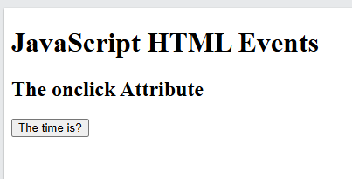
The code changes the content of its own element (using this.innerHTML):
<!DOCTYPE html>
<html>
<body>
<h1>JavaScript HTML Events</h1>
<h2>The onclick Attribute</h2>
<button onclick="this.innerHTML=Date()">The time is?</button>
</body>
</html>
OUTPUT SHOW THE OUPUT AND EXPLANATION

Slide 112
ondblclick Event : The ondblclick event occurs when the user double-clicks on an HTML element.
<html>
<body>
<h1>HTML DOM Events</h1>
<h2>The ondblclick Event</h2>
<p ondblclick="myFunction()">Double-click this paragraph to trigger a function.</p>
<p id="demo"></p>
<script>
function myFunction() {
document.getElementById("demo").innerHTML += "Hello World ";
}
</script>
</body>
</html>
OUTPUT
SHOW

Slide 113
onmouseover Event : The onmouseover event occurs when the mouse pointer enters an element. The onmouseover event is often used together with the onmouseout event, which occurs when the mouse pointer leaves the element.
Syntax In HTML:
<element onmouseover="myScript">

Slide 114
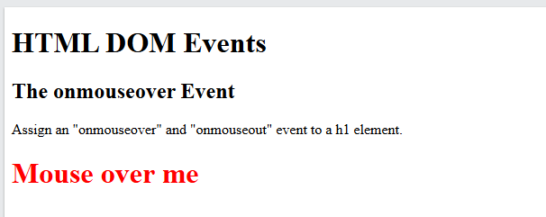
<html>
<body>
<h1>HTML DOM Events</h1>
<h2>The onmouseover Event</h2>
<p>Assign an "onmouseover" and "onmouseout" event to a h1 element.</p>
<h1 id="demo" onmouseover="mouseOver()" onmouseout="mouseOut()">Mouse over me</h1>
<script>
function mouseOver() {
document.getElementById("demo").style.color = "red";
}
function mouseOut() {
document.getElementById("demo").style.color = "black";
}
</script>
</body>
</html>

Slide 115
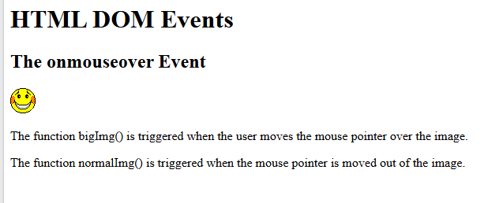
onmouseout Event : The onmouseout event occurs when the mouse pointer moves out of an element.
<html>
<body>
<h1>HTML DOM Events</h1>
<h2>The onmouseover Event</h2>
<img onmouseover="bigImg(this)" onmouseout="normalImg(this)" border="0" src="C:/Users/F4/Desktop/SMILEY.GIF" alt="Smiley" width="32" height="32">
<p>The function bigImg() is triggered when the user moves the mouse pointer over the image.</p>
<p>The function normalImg() is triggered when the mouse pointer is moved out of the image.</p>
<script>
function bigImg(x) {
x.style.height = "64px";
x.style.width = "64px";
}
function normalImg(x) {
x.style.height = "32px";
x.style.width = "32px";
}
</script>
</body>
</html>

Slide 116
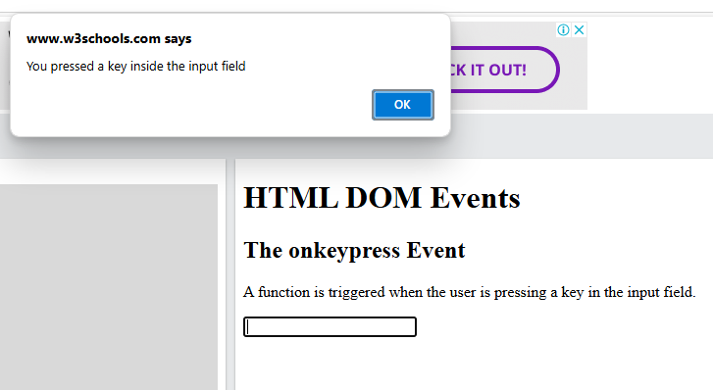
KeyboardEvent : The KeyboardEvent Object handles events that occur when a user presses a key on the keyboard.
onkeypress Event : Call a function when the user presses a key
<html>
<body>
<h1>HTML DOM Events</h1>
<h2>The onkeypress Event</h2>
<p>A function is triggered when the user is pressing a key in the input field.</p>
<input type="text" onkeypress="myFunction()">
<script>
function myFunction() {
alert("You pressed a key inside the input field");
}
</script>
</body>
</html>

Slide 117
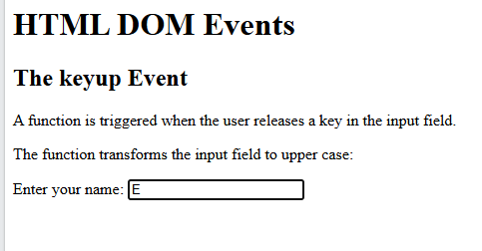
onkeyup Event : Call a function when the user releases a key:
<html>
<body>
<h1>HTML DOM Events</h1>
<h2>The keyup Event</h2>
<p>A function is triggered when the user releases a key in the input field.</p>
<p>The function transforms the input field to upper case:</p>
Enter your name: <input type="text" id="fname" onkeyup="myFunction()">
<script>
function myFunction() {
let x = document.getElementById("fname");
x.value = x.value.toUpperCase();
}
</script>
</body>
</html>

Slide 118
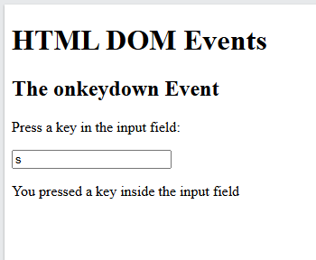
onkeydown Event : Call a function when the user presses a key:
<html>
<body>
<h1>HTML DOM Events</h1>
<h2>The onkeydown Event</h2>
<p>Press a key in the input field:</p>
<input type="text" onkeydown="myFunction()">
<p id="demo"></p>
<script>
function myFunction() {
document.getElementById("demo").innerHTML = "You pressed a key inside the input field";
}
</script>
</body>
</html>

Slide 119
BROWSER EVENTS : Events are fired inside the browser window, and tend to be attached to a specific item that resides in it. This might be a single element, a set of elements, the HTML document loaded in the current tab, or the entire browser window. There are many different types of events that can occur.
onload Event Attribute
The onload attribute fires when an object has been loaded.
onload is most often used within the <body> element to execute a script once a web page has completely loaded all content (including images, script files, CSS files, etc.)

Slide 120
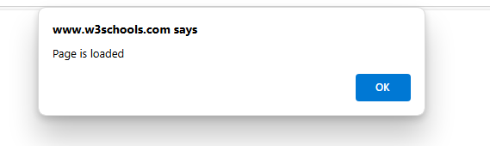
<html>
<head>
<script>
function myFunction() {
alert("Page is loaded");
}
</script>
</head>
<body onload="myFunction()">
<h1>Hello World!</h1>
</body>
</html>

Slide 121
onunload Event
The onunload event occurs once a page has unloaded (or the browser window has been closed).
onunload occurs when the user navigates away from the page (by clicking on a link, submitting a form, closing the browser window, etc.).
Syntax In HTML:
<element onunload="myScript">

Slide 122
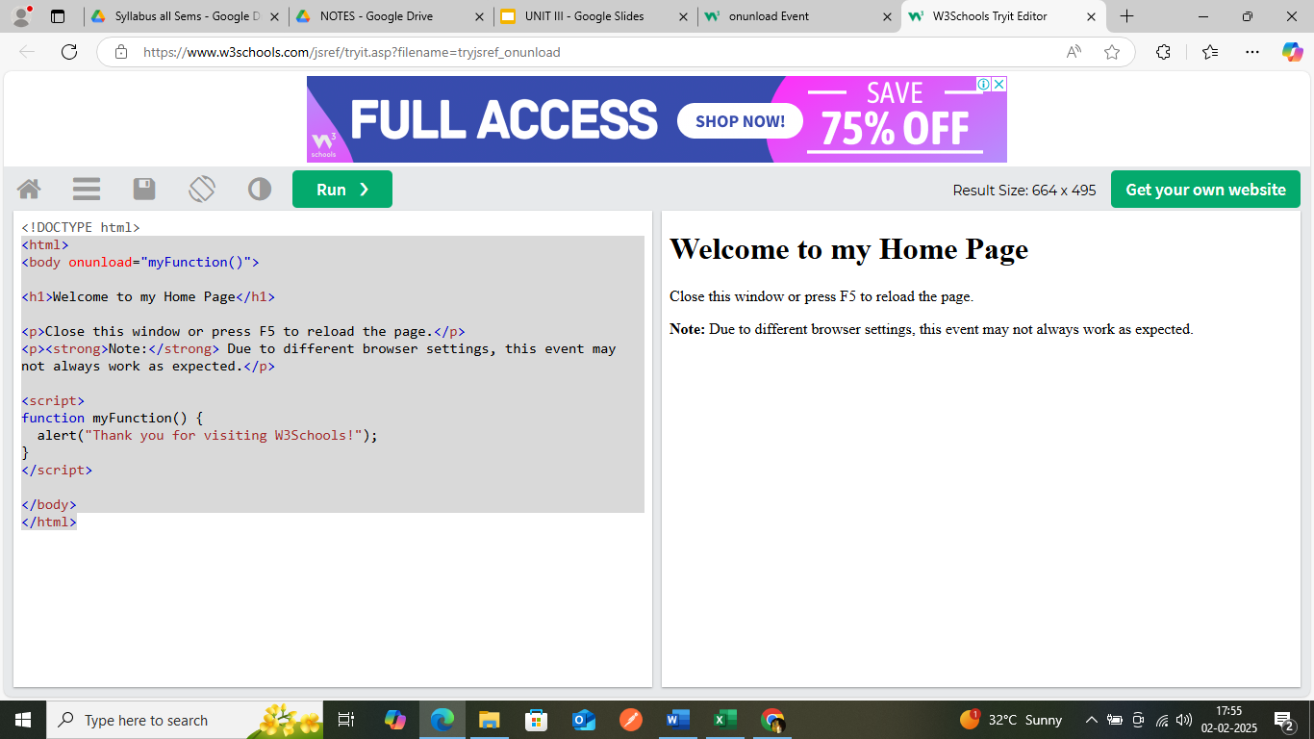
<html>
<body onunload="myFunction()">
<h1>Welcome to my Home Page</h1>
<p>Close this window or press F5 to reload the page.</p>
<p><strong>Note:</strong> Due to different browser settings, this event may not always work as expected.</p>
<script>
function myFunction() {
alert("Thank you for visiting!");
}
</script>
</body>
</html>

Slide 123
onsubmit Event
The onsubmit event occurs when a form is submitted.

Slide 124
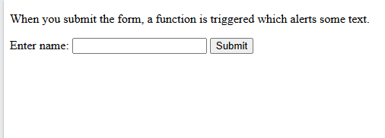
<html>
<body>
<p>When you submit the form, a function is triggered which alerts some text.</p>
<form action="/action_page.php" onsubmit="myFunction()">
Enter name: <input type="text" name="fname">
<input type="submit" value="Submit">
</form>
<script>
function myFunction() {
alert("The form was submitted");
}
</script>
</body>
</html>

Slide 125
Form Validation
HTML form validation can be done by JavaScript.
If a form field (fname) is empty, this function alerts a message, and returns false, to prevent the form from being submitted:

Slide 126
<html>
<head>
<script>
function validateForm() {
let x = document.forms["myForm"]["fname"].value;
if (x == "") {
alert("Name must be filled out");
return false;
}
}
</script>
</head>

Slide 127
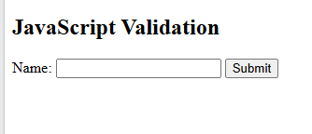
<body>
<h2>JavaScript Validation</h2>
<form name="myForm" action="/action_page.php" onsubmit="return validateForm()" method="post">
Name: <input type="text" name="fname">
<input type="submit" value="Submit">
</form>
</body>
</html>

